Slide 1

Real Time Face Mask Detection and Social Distance Monitoring
Inhouse Project
Project Mentor : Dr. (Mrs.) Sujata Khedkar
Group Number : 08
Group Members :
Shreyas Kotkar D12C - 34 (Leader)
Chirag Kinger D12C - 31
Vikram Virwani D12B - 68
Yashkumar Jain D12B - 24

Slide 2
Content
Shreyas Kotkar - 34 -D12C
Introduction to Project
Lacuna in the existing systems
Problem Definition
Literature Survey
Methodology employed
Hardware, Software, tools and the constraints
Block Diagram
Modular Diagram
Next Work Plan
Conclusion
References

Slide 3
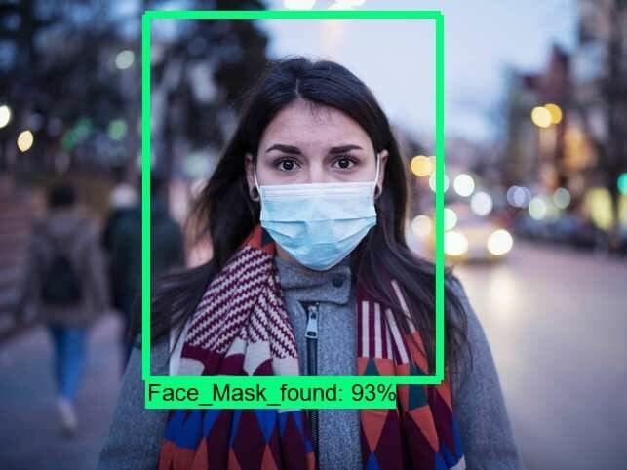
Introduction to Project
Vikram Virwani-68-D12B
COVID-19 is an emerging infectious disease.
Approach to preventing the spread of the virus.
Facemask-wearing is valuable.
Facemask-wearing provide an opportunity for automatic identification.
Machine learning has presented opportunities for development

Slide 4
Lacuna in the existing system
Vikram Virwani-68-D12B
There is no such system available in India to be used in school or college campuses or public places.
All the existing system are either face mask detector or social distancing manager but our model is combination of both.

Slide 5
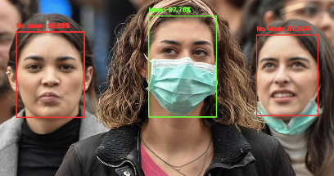
Problem Definition
Vikram Virwani-68-D12B
To build a system that can detect and identify if the detected faces are wearing masks or not.
Real-world videos are entirely different from the videos captured by webcams or selfie cameras.
We will explore mask/ no mask classification
Classification problem in real-world videos as our
final goal.

Slide 6
Literature Survey
Yashkumar Jain - 24 -D12B
Sr. No. | Title | Algorithm Used | Year
1 | Face Mask Detector with OpenCV, Keras/TensorFlow, and Deep Learning by Adrian Rosebrock | OpenCV and Keras/TensorFlow and Deep Learning | 05-2020
2 | A Vision-based Social Distancing and Critical Density Detection System for COVID-19 | AI, machine learning and computer vision | 07 - 2020
3 | Algorithm for Face Detection Combining Geometry Constraints and Face-Mask | combines geometry constraints and face-mask | 06 - 2013
4 | Face Recognition with Facial Mask Application and Neural Networks | DCT, MLP and RBF Neural Network | 06-2013
5 | Enabling and Emerging Technologies for Social Distancing: A Comprehensive Survey | AI, machine learning, computer vision, ultrasonic etc. | 05-2020

Slide 7
Literature Survey
Shreyas Kotkar - 34 -D12C
Sr. No. | Title | Algorithm Used | Year
6 | Face Mask Detection using Transfer Learning of InceptionV3 | RCNN, SSD, YOLO | 07-2020
7 | A Review on Face Mask Detection using Convolutional Neural Network | MobileNet V2 classifier, SVM, PCA | 11-2020
8 | Applying deep learning algorithm to maintain social distance in public place through drone technology | YOLO-v3, Darknet-53 | 05-2020
9 | Deep Learning based Safe Social Distancing and Face Mask Detection in Public Areas for COVID-19 Safety Guidelines Adherence | RCNN, MobileNet V2 classifier, SSD, YOLO-v3, Computer Vision | 12-2020
10 | Real-Time Face Mask Identification Using Facemask Net Deep Learning Network | Facemask Net, ReLu | 07-2020

Slide 8
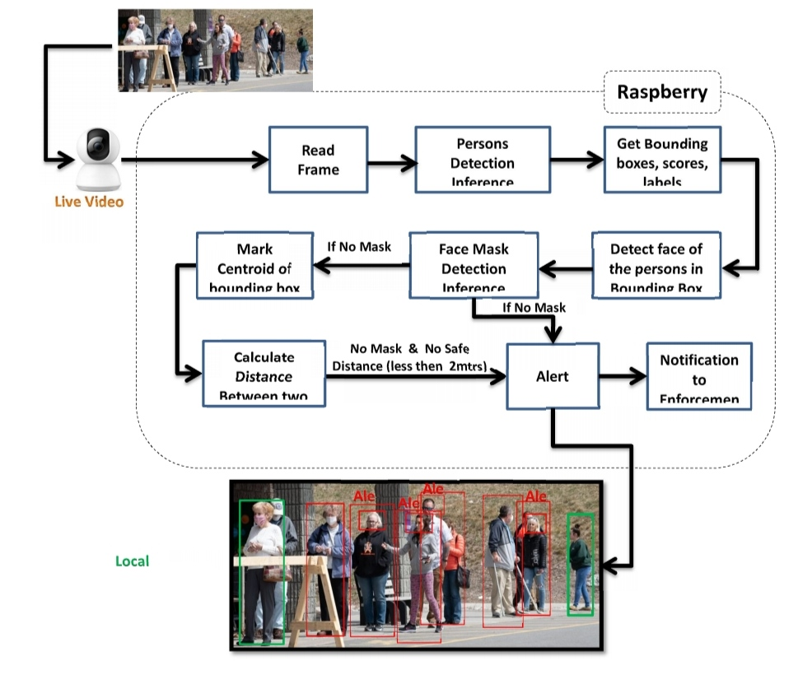

Methodology Employed
Shreyas Kotkar - 34 -D12C

Slide 9

Hardware, Software, Tools and constraint
Chirag Kinger - 34 -D12C
Software : Anaconda + Python 3.x (3.8 or earlier)
Editor : VS Code/ PyCharm/ Sublime/ Spyder
Implementing our COVID-19 face mask detector training script with Keras and TensorFlow.
To accomplish this task, we'll be fine-tuning the MobileNet V2 architecture.
HARDWARE:
GPU : Graphics Processor (NVIDIA) min 2GB
Camera : CCTV/ Webcam/ Mobile Camera
Storage Disk : SSD - Min 400MB/s Read Speed

Slide 10
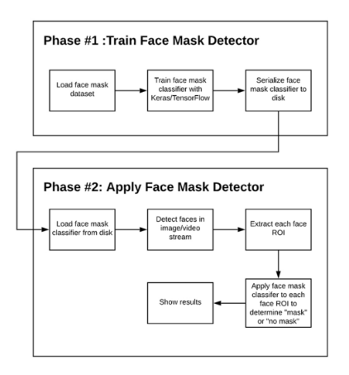
Block Diagram
(Face Mask Detector)
Chirag Kinger-31-D12C

Slide 11
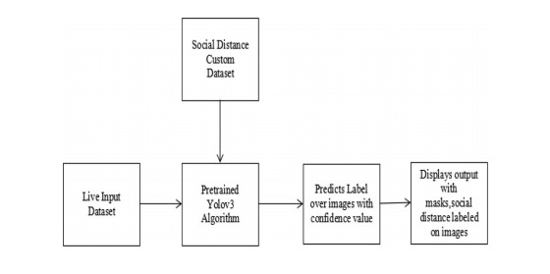
Block Diagram (Social Distance Detector)
Chirag Kinger - 34 -D12C

Slide 12
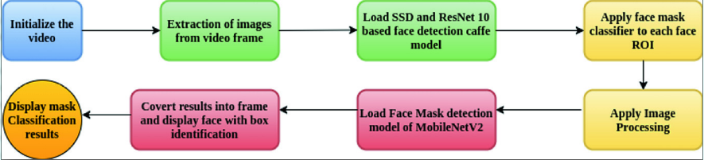
Modular Diagram
Chirag Kinger-31-D12C

Slide 13
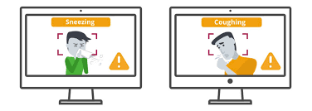
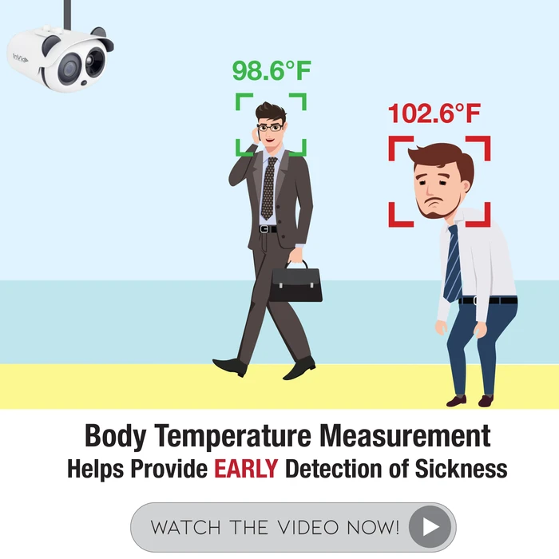
Next Work Plan
Yashkumar Jain-24-D12B
Used in Public Places such as Offices, markets, Airports, etc. :-
Coughing and Sneezing Detection :-
Temperature Screening :-

Slide 14
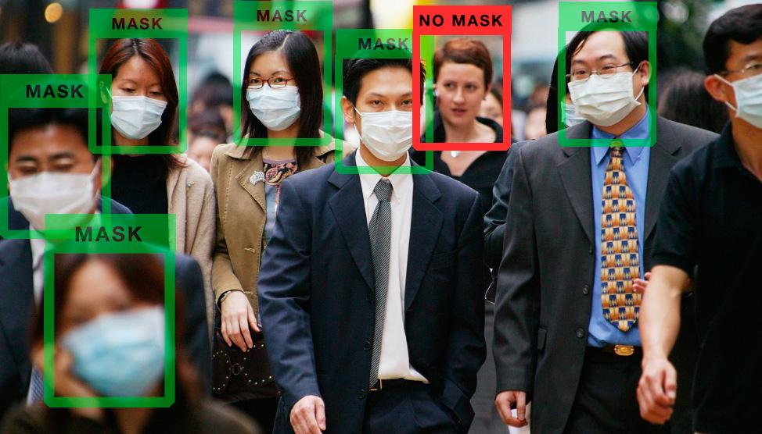
Conclusion
Yashkumar Jain-24-D12B
System will operate in an efficient manner in the current situation when the lockout is eased and helps to track public places.
System would improve public safety
Prevention of epidemic diseases including COVID-19 in public.
Different Model will be used and among them the best model with highest prediction value will be selected.

Slide 15
References
Yashkumar Jain-24-D12B
●P. Viola and M. Jones, “Rapid object detection using a boosted cascade of simple features,” in Proceedings of the 2001 IEEE computer society conference on computer vision and pattern recognition. CVPR 2001, vol.1. IEEE, 2001, pp. I–I.
●R. Girshick, J. Donahue, T. Darrell, and J. Malik, “Rich feature hierarchies for accurate object detection and semantic segmentation,” in Proceedings of the IEEE conference on computer vision and pattern recognition,2014, pp. 580–587.
●R. Girshick, “Fast r-cnn,” in Proceedings of the IEEE international conference on computer vision, 2015,pp. 1440–1448.
●S. Ren, K. He, R. Girshick, and J. Sun, “Faster r-cnn: Towards real-time object detection with region proposal networks,” in Advances in neural information processing systems, 2015, pp. 91–99.
●W. Liu, D. Anguelov, D. Erhan, C. Szegedy, S. Reed, C.-Y. Fu, and A. C. Berg, “Ssd: Single shot multibox detector,” in European conference on computer vision. Springer, 2016, pp. 21–37.
● J. Redmon, S. Divvala, R. Girshick, and A. Farhadi, “You only look once: Uniﬁed, real-time object detection,” in Proceedings of the IEEE conference on computer vision and pattern recognition, 2016, pp. 779–788.

Slide 16
THANK YOU!!

